Slide 1
Algae
Alternation of Generation
Dr. Trilok Kumar
Assistant Professor
Govt. Digvijay Autonomous PG College, Rajnandgaon, C.G.

Slide 2
ALTERNATION OF GENERATION
Life Cycle: A general term for an organism's life stages(From germination to reproduction).
The sequence of events through which one generation passes into the next generation is called life cycle.
Alternation of Generation: A specific type of life cycle (mainly plants/algae) featuring alternating multicellular haploid (n/gametophytic phase) and diploid (2n/ Sporophytic phase)
Sexual reproduction involves alternation between haploid and diploid generation which we call alternation of generation.

Slide 3
TYPES OF ALTERNATION OF GENERATION
In algae, there are five main types of life cycles or alternation of generation.
1-Haplontic alternation of generation
2-Diplontic alternation of generation
3-Diplohaplontic alternation of generation
4-Haplobiontic alternation of generation
5-Diplobiontic alternation of generation

Slide 4
1-Haplontic Life Cycle-
In this type of life cycle the main plant body is gametophytic (haploid) that produces mitospore during growing season that develops into gametophytic plant.
Towards the end of the growing season gametophyte produces gametes (haploid).
Zygote/zydospore (diploid) is formed after gametic fusion, which is the only diploid phase in the life cycle.
Soon after their formation zygospores/zygote divides by meiosis to form meiospores that germinates into gametophytic thallus.
Such a life cycle is called haplontic life cycle and the most primitive one in which zygotic meiosis takes place and there is no formation of sporophytic thallus (diploid).
This type of life cycle is shown by majority of green algae, Charophytes and Bangia of red algae.

Slide 5
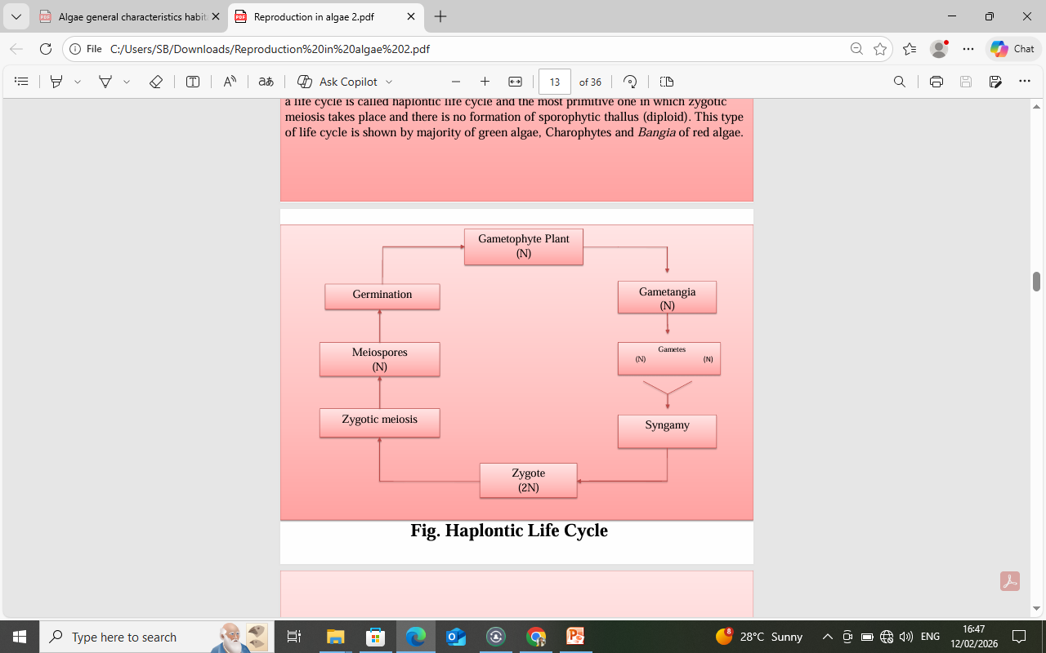
n n

Slide 6
2-Diplontic Life Cycle-
The dominant plant thallus is diploid.
The thallus reproduces sexually by gametes that are formed by meiosis in sex organs.
These gametes represent the haploid phase in the life cycle.
These gametes fuse to form zygote/zygospore that ultimately forms the diploid plant body.
No true alternation of generation as in the first case (haplontic) occurs.
This type of life cycle is called diplontic life cycle.
This life cycle is shown by Diatoms (Bacillariophyceae), some members of Siphonales, Siphonocladiales and Dasycladiales of green algae and Fucales of Brown algae.

Slide 7
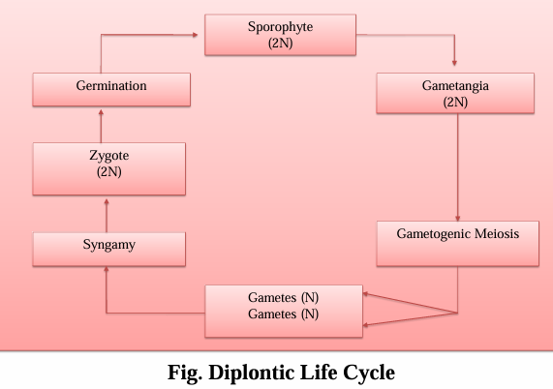
2n 2n

Slide 8
3-Diplohaplontic Life Cycle-
This type of life cycle found in Ulvales and Cladophorales of Chlorophyceae and some brown algae (Ectocarpus, Dictyota).
In this type of life cycle two different generations alternate each other.
True alternation of generation is occurs.
This type of life cycle that consists of two different vegetative individuals alternating with each other is called diplohaplontic.
There are two types of diplohaplontic life cycles-
(i) Isomorphic diplohaplontic
(ii) Heteromorphic diplohaplontic

Slide 9
Isomorphic diplohaplontic life cycle-
In isomorphic diplohaplontic life cycle, alternating sporophyte and gametophyte are morphologically similar.
Zygote produces sporophytic thallus that produces meiospores in sporangium by reduction division.
Meiospores germinate to form a gametophytic thallus that forms gamtes in sex organs.
Syngamy between gametes yields zygote that produces diploid thallus.
E.g., Ulvales, Cladophorales, Ectocarpales, Dictyotales and red algae.
(ii) Heteromorphic diplohaplontic life cycle -
In heteromorphic diplohaplontic life cycle, alternating generations are morphologically dissimilar.
Sporophyte has elaborate development as compared to the gametophyte. E.g., Laminariales, Desmarestiales etc.

Slide 10
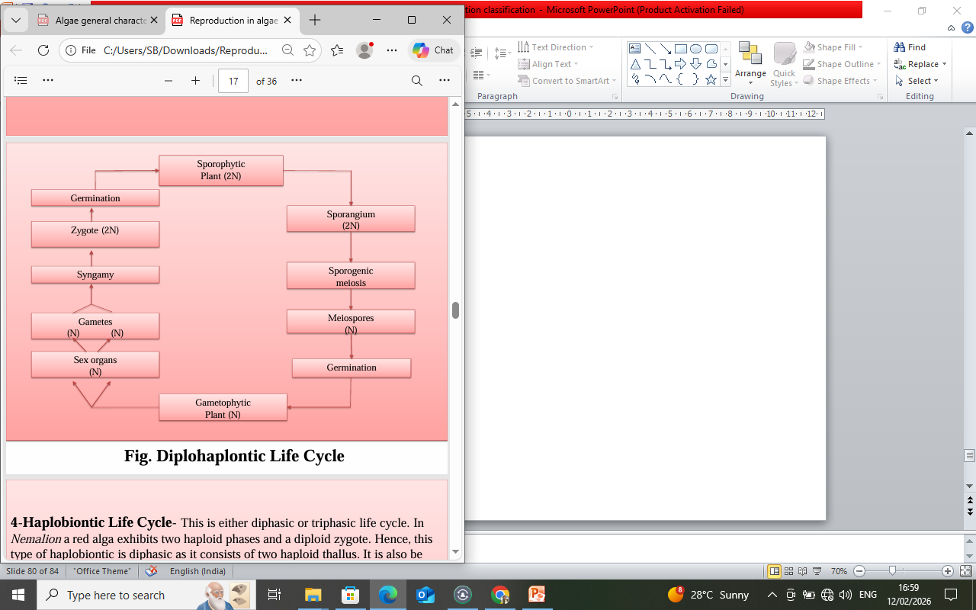
2n n 2n

Slide 11
4-Haplobiontic Life Cycle-
This is either diphasic or triphasic life cycle.
In Nemalion a red alga exhibits two haploid phases and a diploid zygote.
Hence, this type of haplobiontic is diphasic as it consists of two haploid thallus.
It is also be called as haplo-haplontic.
In Nemalion dominant phase is a gametophyte that produces gametes.
Zygote is formed after gametic union that develops into carposporophyte after meiosis.
Carposporophyte produces carpospores that ultimately germinate into main gametophytic plant body.
Batrachospermum (red alga) do exhibit haplobiontic life cycle but it is triphasic as it consists of three prominent haploid phases (main gametophyte, carposporophyte and chatransia phase).
Therefore, this life cycle may be called as haplo-haplo haplontic life cycle.
Zygote is the only diploid phase.
The main plant body which is gametophyte produces gametes.
These gametes fuse to form zygote that undergoes meiosis and develops into carposporophyte.
Carpospores of carposporophyte germinates to form chatransia stage. Chatransia stage then develops into normal gametophyte.

Slide 12
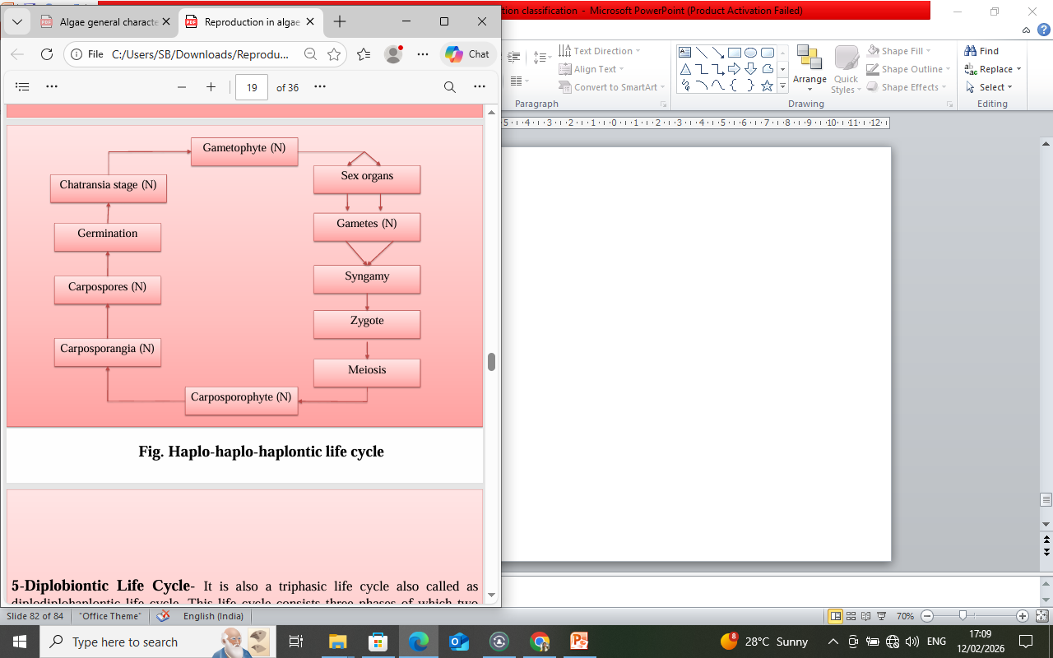
2n
n n n
Gamentophyte Carposporophyte Chatransia stage

Slide 13
5-Diplobiontic Life Cycle-
It is also a triphasic life cycle also called as diplodiplohaplontic life cycle.
This life cycle consists three phases of which two phases are diploid and one is haploid.
The main plant body is gametophyte that produces gametes.
Zygote is formed by syngamy.
In this life cycle, zygote differentiates into diploid carposporophyte.
Diploid carposporangia develops in carposporophyte and diploid carpospores are produced within carposporangia.
On liberation, carpospores develops into diploid tetrasporophyte.
Tetraspores (n) are produced after meiosis inside tetrasporangia.
Tetraspores (n) finnaly develops into main gametophytic plant thallus.
e.g.: Polysiphonia (Red algae)

Slide 14
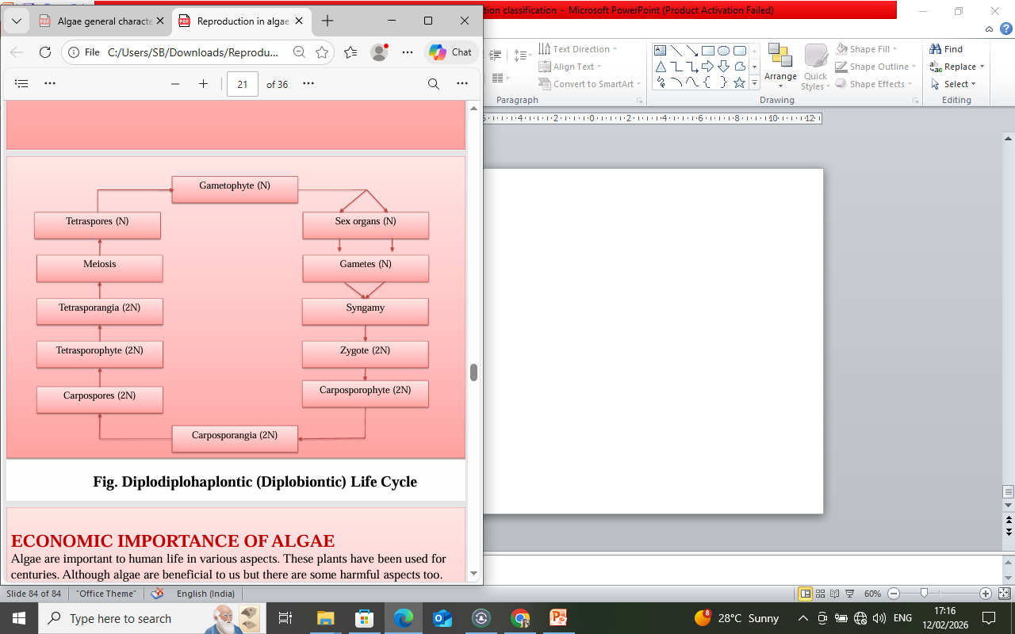
2n 2n n
Carposporophyte Tetrasporophyte Gametophyte

